Slide 1
NOVENA 2023
TO BLESSED
ANTONIO ROSMINI
IN PRAYER FOR PEACE
22-30 JUNE

Slide 2
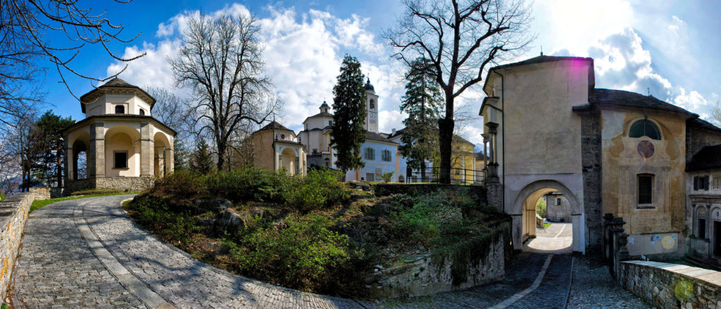
Day 1:
THURSDAY 22 JUNE

Slide 3
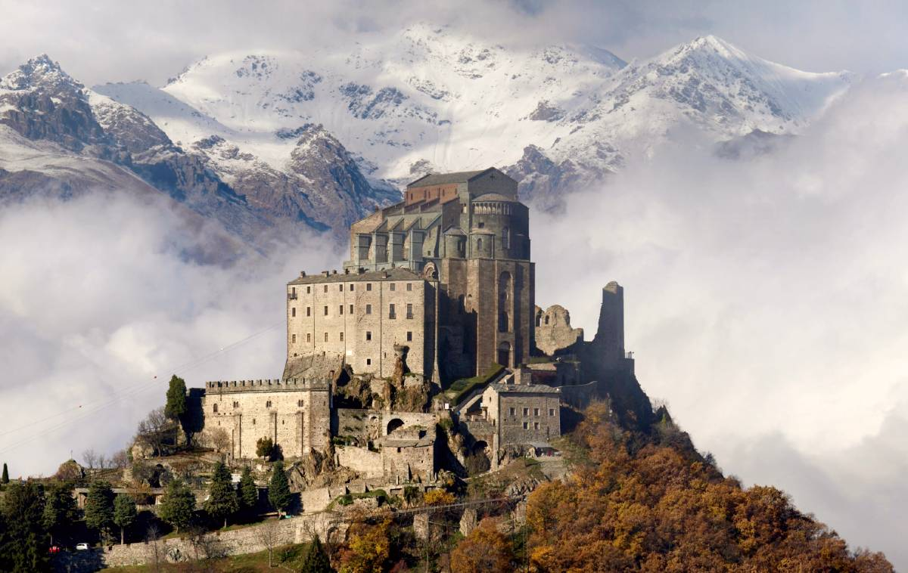
Peace begins with me and my heart, my life.

Slide 4
Let us pray for peace in the hearts of those loved by the Lord, and for every believer to become an instrument of the peace of Him who is God and Prince of Peace.

Slide 5
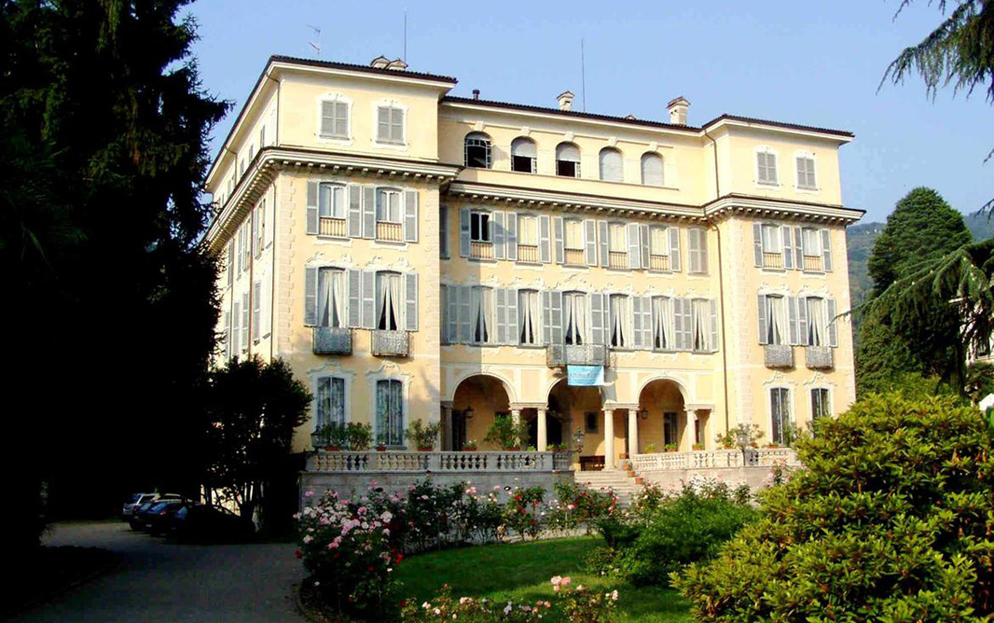
Day 2:
FRIDAY 23 JUNE

Slide 6
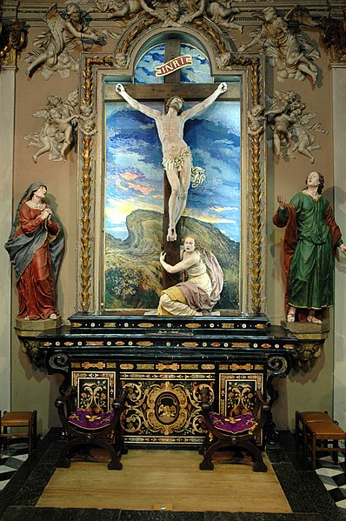
Peace where
there is war.

Slide 7
Let us pray for all areas of the world where there is war between different peoples and ethnic groups, that weapons may be silenced and peace may speak: in dialogue, in reconciliation, in forgiveness.

Slide 8
For the good of people and humanity, there can be no more war, which destroys God's creation, and especially man and woman, created in His image.

Slide 9
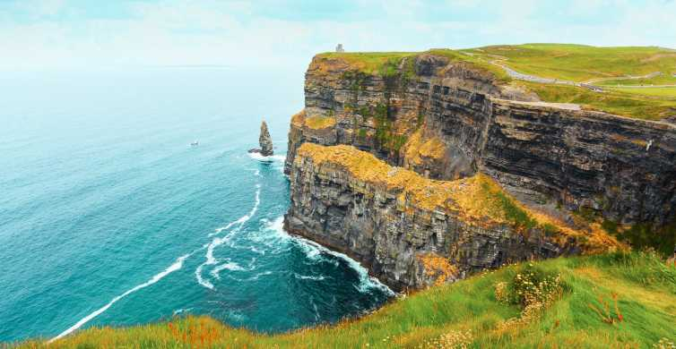
Day 3: SATURDAY 24 JUNE - NATIVITY OF SAINT JOHN BAPTIST

Slide 10
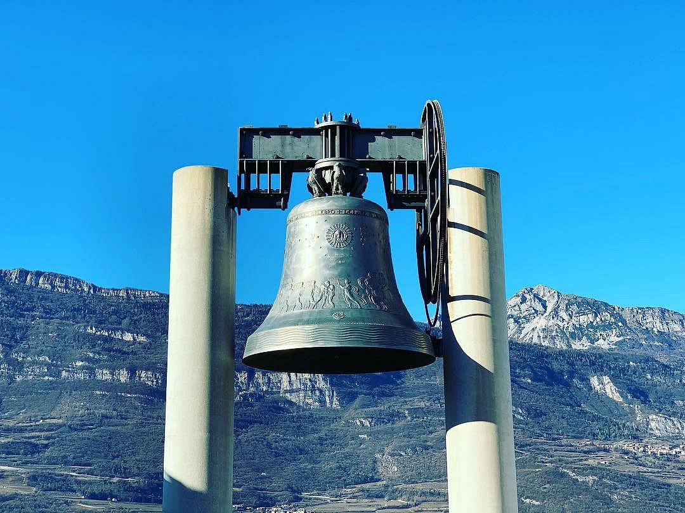
Peace where
there is
violence.

Slide 11
We pray for peace in every situation of violence: in families, communities, villages, and countries.

Slide 12
For peace in every situation where people think to solve problems with violence. For peace in every instance of discrimination, classism, exclusion, bullying.

Slide 13
Grant us Lord, always, to live proximity, friendship, fraternity.

Slide 14
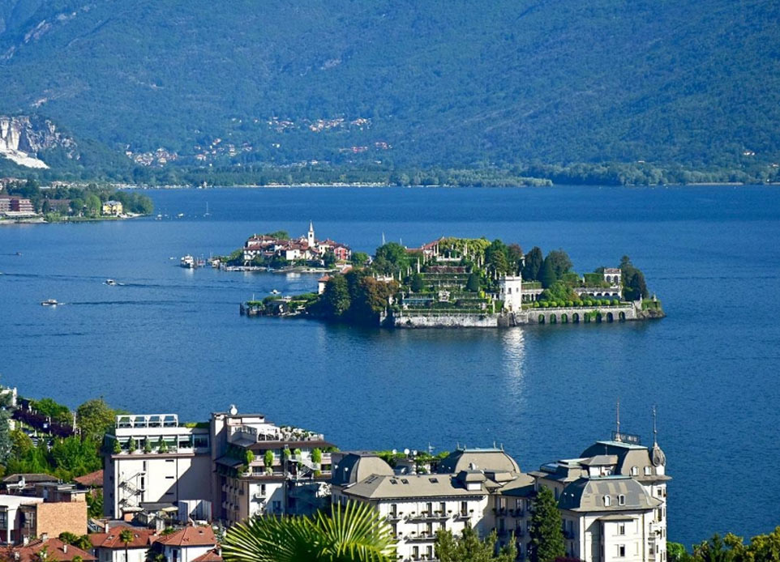
Day 4: SUNDAY
25 JUNE - XII OF ORDINARY TIME

Slide 15
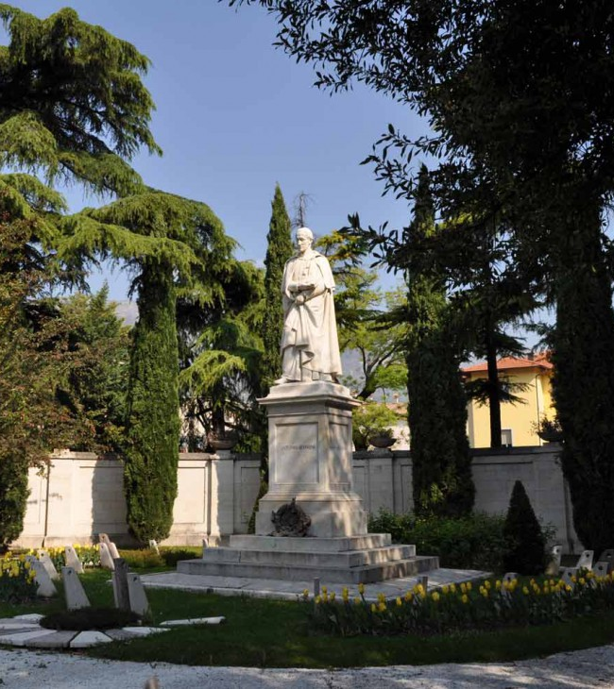
Peace where there is no dialogue.

Slide 16
Let us pray for peace between silent parties, between brothers and sisters who do not dialogue, between people who hold grudges and are driven by prejudice.

Slide 17
For peace in situations where dialogue seems to have ended forever: give us Lord the humility of listening and dialogue.

Slide 18
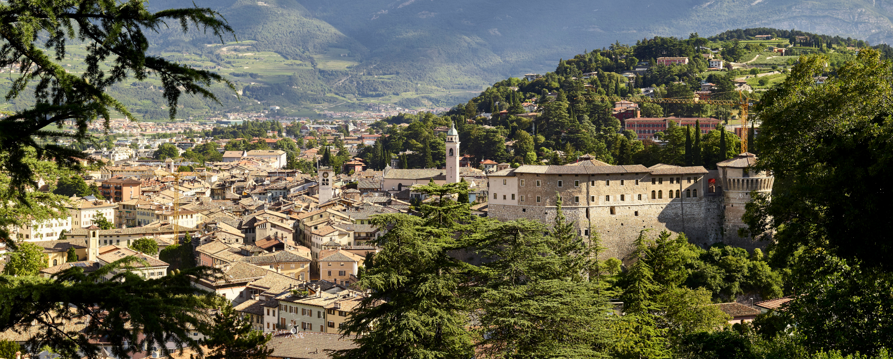
Day 5 MONDAY 26 JUNE

Slide 19
Social peace

Slide 20
Let us pray for peace in countries experiencing social instability due to the consequences of war, dictatorial regimes or governments that restrict citizens' freedom.

Slide 21
For countries experiencing political, economic, moral, and spiritual crises: may the desire for the true good of the people, action for justice and the reasons for the common good prevail.

Slide 22
Lord, inspire in all hearts the will to build peace, the desire to follow paths that build society in justice and the common good.

Slide 23
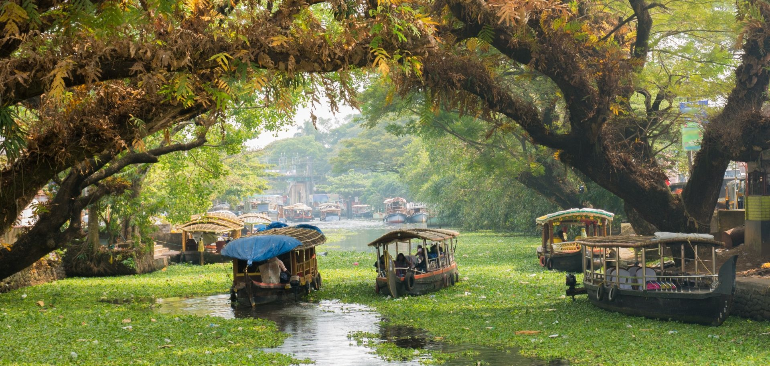
Day 6: TUESDAY
27 JUNE - NOSTRA SIGNORA DEL PERPETUO SOCCORSO

Slide 24
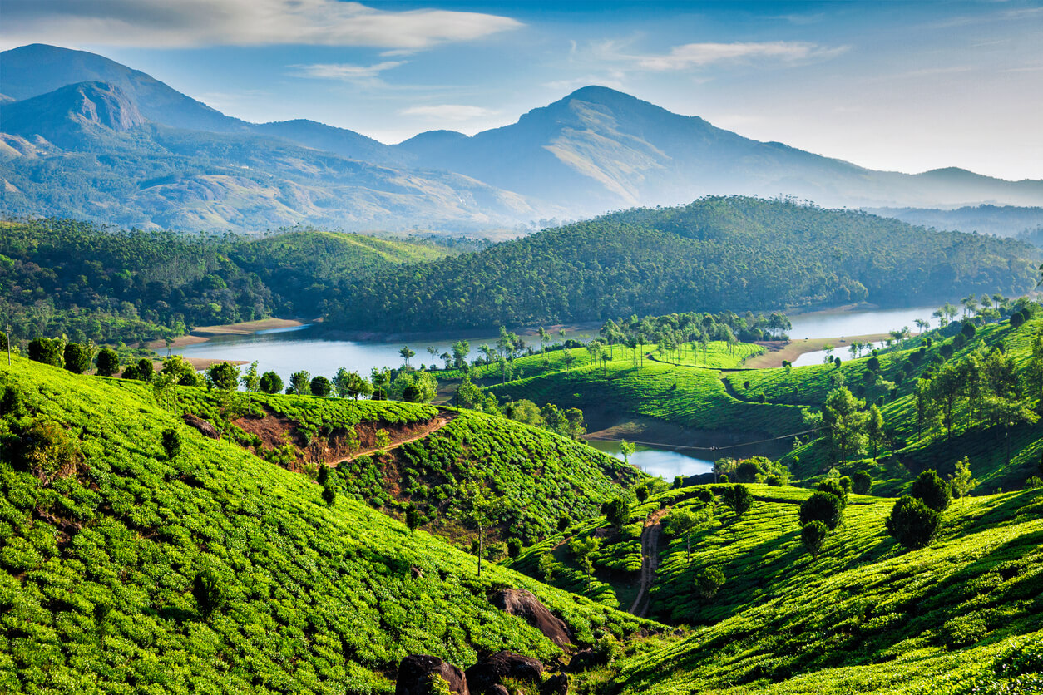
Peace where there is no awareness
of the
common good.

Slide 25
Let us pray for the areas in the world most affected by the phenomenon of migration, and where migrants are oppressed by discrimination, xenophobia, and situations that offend their dignity as persons and as a people.

Slide 26
We pray that in everyone, and especially in the younger generations, education in human and Christian values will sow the seeds of the civilisation of love and truth. For either we are saved together, or no one is saved.

Slide 27
Give us, Lord,
compassion in our hearts so that we may always act in your charity.

Slide 28
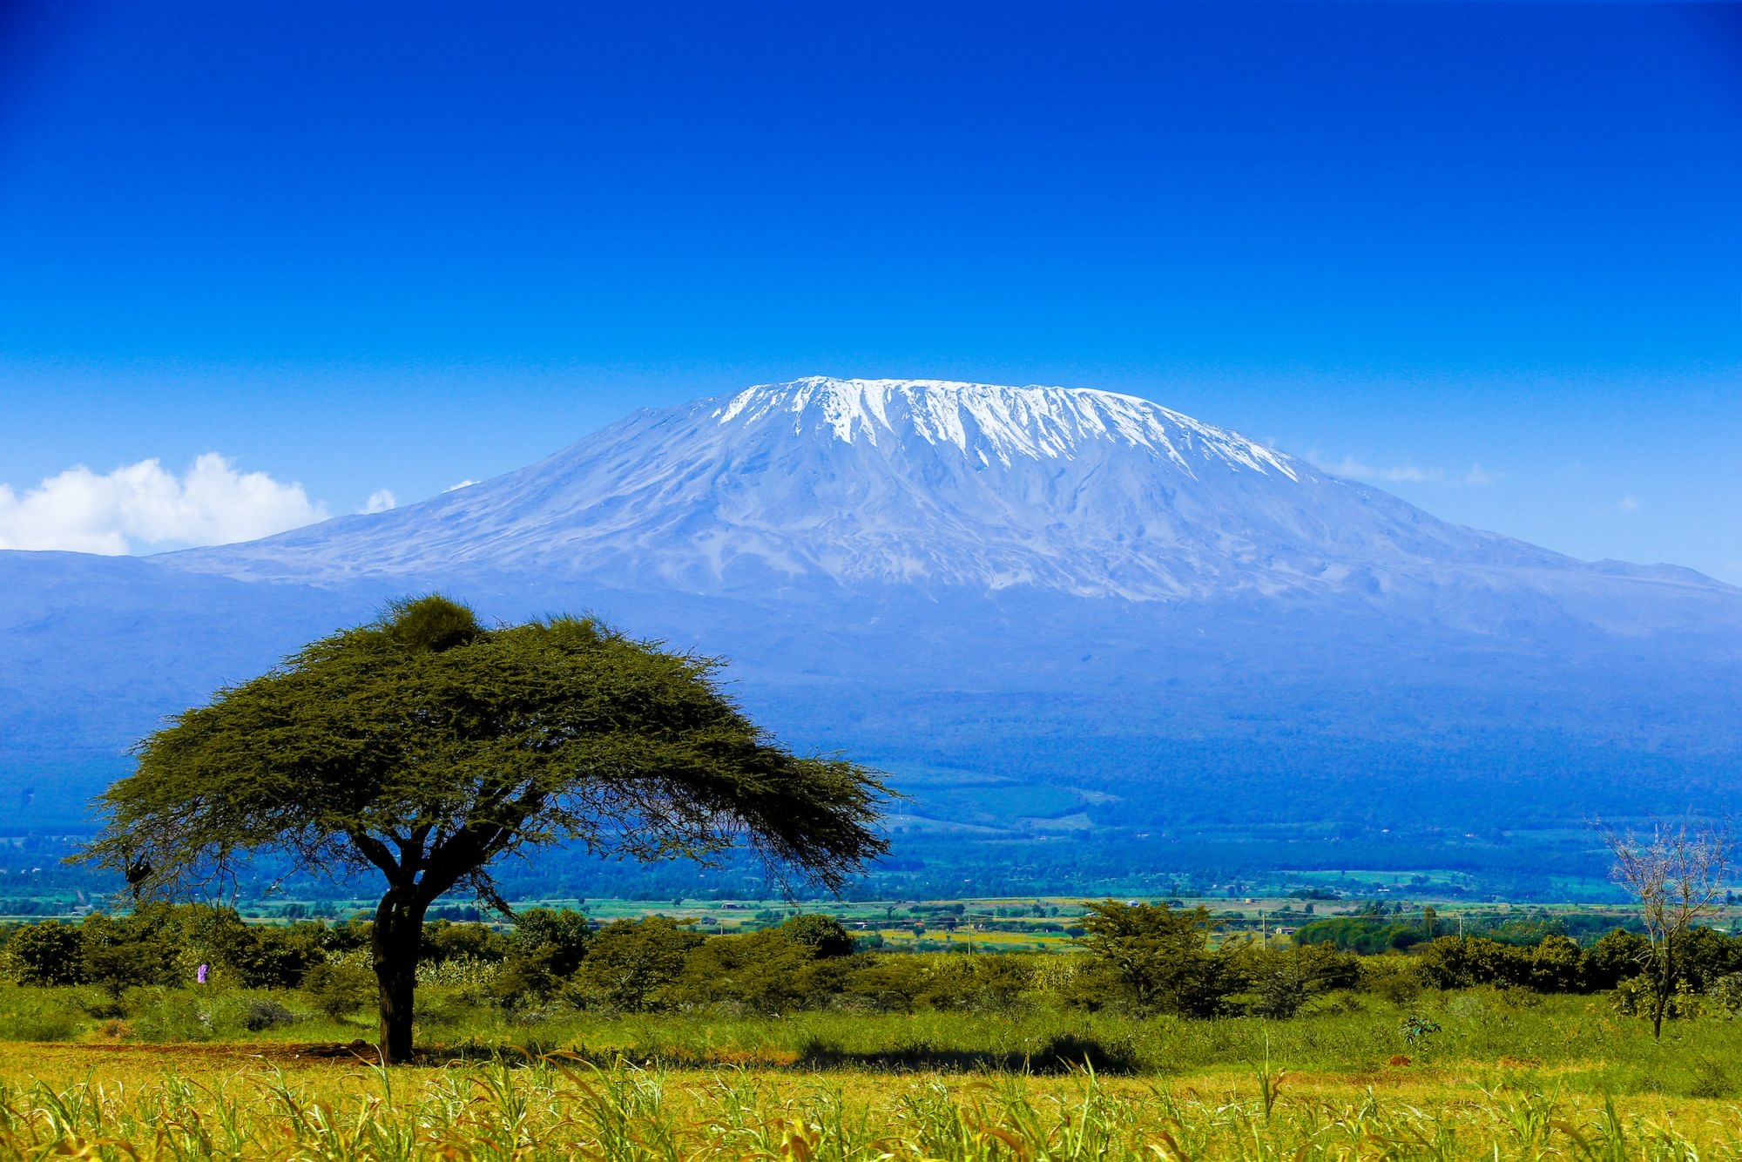
Day 7: WEDNESDAY
28 JUNE - S. IRENEO

Slide 29
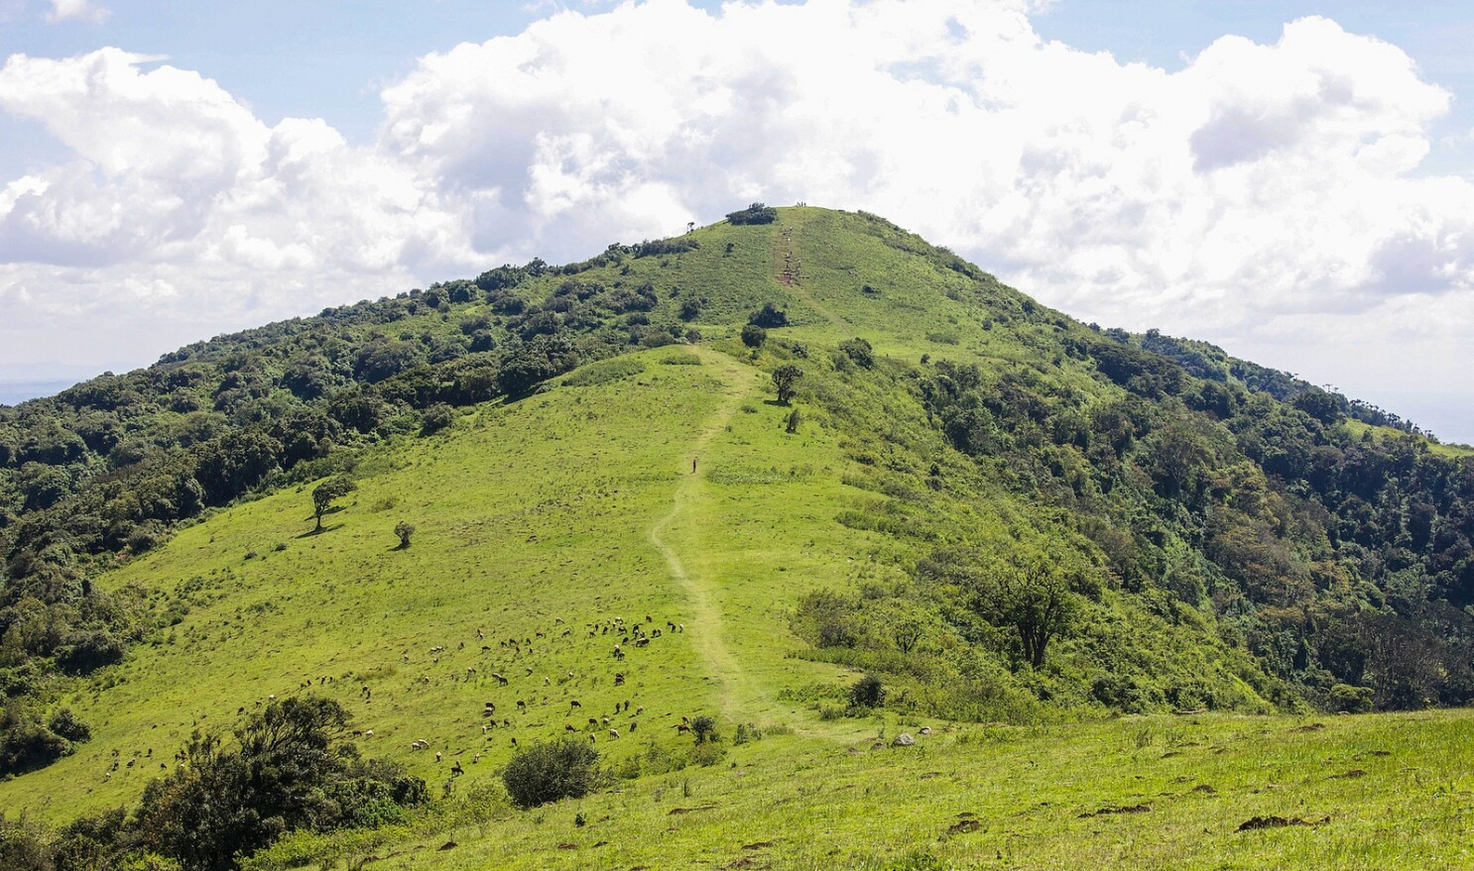
Peace where there is no welcome.

Slide 30
Let us pray for migrant families, for refugees and for all those who are forced to leave their country.

Slide 31
We pray for the host countries that receive refugees and migrants, for those who have to make decisions to foster acceptance, integration and behaviour of civilisation and humanity.

Slide 32
Give us, Lord, your peace to make possible concord and the birth of a more just and fraternal world, in which we can look upon each other as sons and daughters of the same Father.

Slide 33
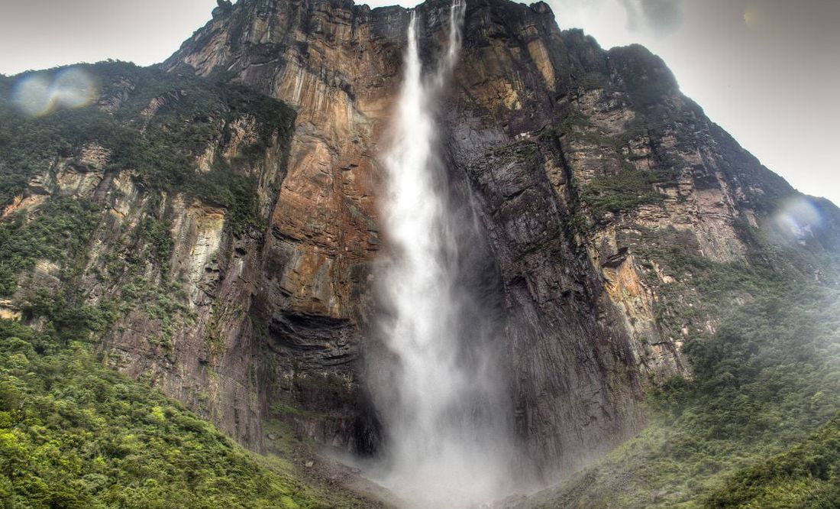
Day 8: THURSDAY 29 JUNE - SAINT APOSTLES PETER AND PAUL

Slide 34
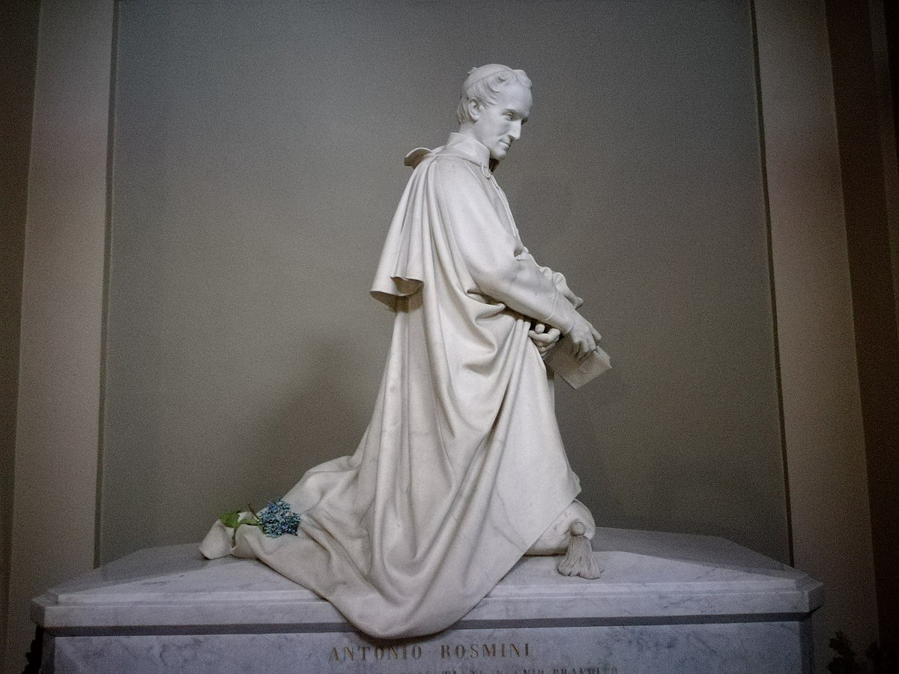
Peace where there is no fraternity.

Slide 35
Let us pray for peace in a world in which we can all recognise ourselves as brothers and sisters.

Slide 36
Let us pray that God will transform all enmity, aversion, and exclusion, often the result of ignorance, superstition, and prejudice, into the symphony of the Holy Spirit for a path of peace throughout the world.

Slide 37
Lord, transform the histories and traditions of division - between people, between towns and villages, and between nations - into paths of peace and fraternity.

Slide 38
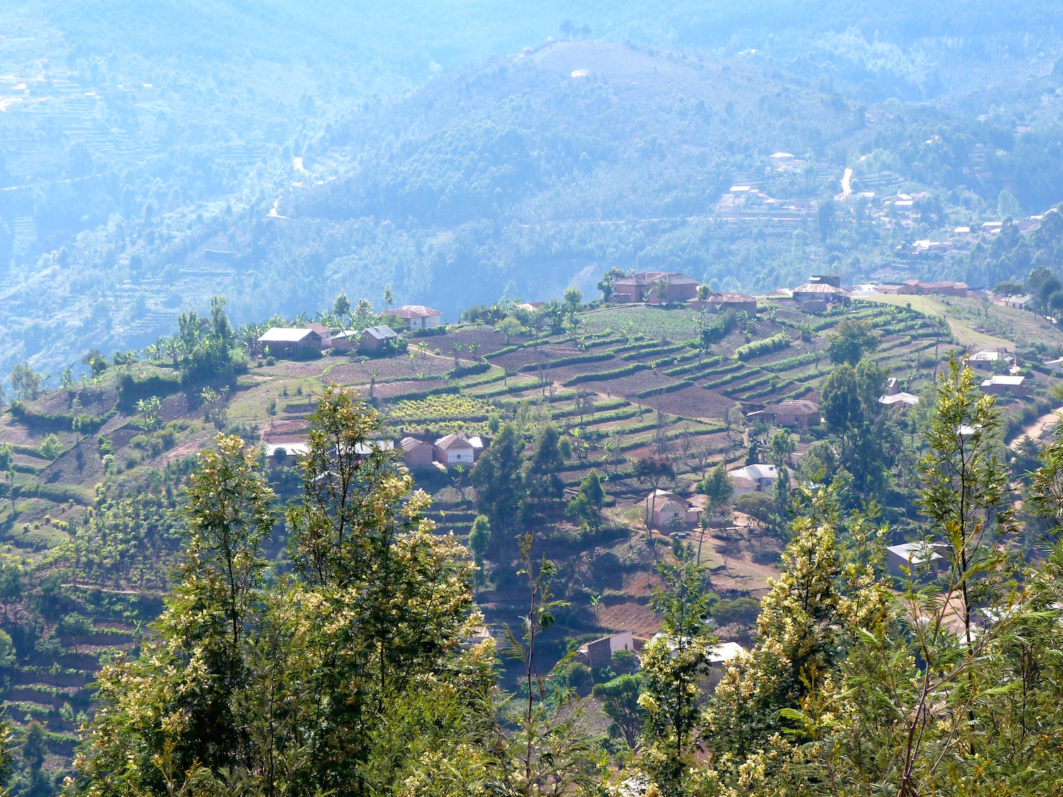
Day 9: FRIDAY
30 JUNE

Slide 39
Peace, gift
of the Spirit!

Slide 40
Let us pray for peace, invoking the breath of the Holy Spirit to repel the winds of nuclear disaster.

Slide 41
Renew, O Holy Spirit, the face of the earth and the face of all peoples that they may be one family in peace.

Slide 42
Help us to live universal love, banish from us the senseless thought and desire for universal destruction that does not come from you and your Love.

