Slide 1
ONGOING FORMATION: RATIO FORMATIONIS
INDIAN PROVINCE OF THE IOC
November 8th, 2023

Slide 2
What is RF? Plan of Formation It’s good to have a plan and a purpose in life!
Formation: lifetime duration [RL 88 … we remain contemplative…].
Why?
Contemplating the Master and following his example: prayer and action…characteristic ”which they have made their own” [C 486, quoting Lk 10:42 and Mt 25:40]
RF n. 1

Slide 3
Jesus I love you, I want to follow you
and I know that along all my life
you are ready to lead me and accompany me:
please teach me your ways
and show me your will, year after year
but also day by day and Minute by minute!
Help me to live with you
the sacrament of the present moment,
… your eternal present. Amen

Slide 4
What is for the RF?
To put in practice the charism (Const – RL) [D50, GC 98 and 08]
and listening to the Church [PI 98; CIC 650,1; 659,2; VC 68].
RF n. 2

Slide 5
I’m now 10/15/25/30 years in the Institute: is the charism incarnated in my life?
Am I living the charism of Charity?
Am I an obedient son of the Church? (S. Teresia of Avila)

Slide 6
I’m the Institute of Charity
How I live the Charism of Charity in my daily life?

Slide 7
Where RF come from?
It springs from lived experience of rosminians and back with the question: how to incarnate today the charism? My conversion, purification and sanctification is not in the past, it’s my present and my future…
Freedom of the member towards the Constitutions, laws, [C 706] etc. AND action of the Institute towards the brother to prepare him for the work of charity [C 707].
In fact Formation is the first work of charity assumed by the Institute; formation is totally part of the elective state .
RF n. 3

Slide 8
Who is for the RF?
Ratio is for all the Institute : the concept of continuous formation
PI, 1: the renewal of the religious institutes depends principally on the formation of its members
For the formators…WHO ARE THEY?
For formees and their formator…as a group, a community IN formation
RF n. 4

Slide 9
Why a RF?
Biblical images, in relationship with the images of the Church itself:
LG 6-7; CCC 751-757: sheepfold, cultivated field, building of God, family, temple, “Jerusalem from above”; “our mother”.
and the great image of the body of Christ as in Jhon 15:
communion, perfection, see C 182-183, as a typical image of AR
RF n. 7-15

Slide 10
JOURNEY
I AM THE WAY
BELIEVERS: THOSE OF THE WAY
H ODOS

Slide 11
FIELD
YOU ARE GOD’S FIELD
IF I DO NOT CULTIVATE MY FIELD I SHALL HAVE NOTHING TO EAT

Slide 12
THE HOUSE FOUNDATION I IS ESSENTIAL: 1COR 3:10-11
ON A ROCK: MT 7:24-27
A PLAN: LK 14:28-30
IF THE LORD DOES NOT BUILD THE HOUSE…(PS 127)

Slide 13
THE BODY
FORMATION IS A PROCESS, DEVELOPMENT, GROWTH
EPH 5:25-27.32

Slide 14
PERSON’S POTENTIALS
UNDIVIDED HEART 1COR 7
YOU TAKE CONTROL OF ALL MY POTENTIALS, YOU MY HEAD, YOU MY LIFE, YOU MY GOD!

Slide 15
THE SEED
THE GREAT PARABLE MK 4:3-9
THE RF IS AN INSTRUMENT FOR THE GROWTH OF THE SEED OF VOCATION

Slide 16
FIRE
PASSIONATE DESIRE FOR GOD
LOVE OF ONE’S VOCATION
I HAVE COME TO BRING LIVING FIRE…LK 12:49

Slide 17
THE BREAD WE SHARE THE LIFE!
TO CREATE SHARING AS NORMAL WAY TO LIVE
FRATERNITY
TO BECOME ONE BREAD… OUR LIFE BROKEN
REMAIN IN MY LOVE (JH 15:9) BREAD

Slide 18
HOW TO EXPRESS OUR FORMATIVE PROCESS ALONG THE LIFE?
The contemplative dimension of life (i), to make an indispensable space for
listening to the Word (ii) corresponded and lived in
fraternity (iii),
through Charity (iv), so that
God could be all in everyone
(1Cor 15:28).
RF n. 67

Slide 19
Apostolic community: FRACTIO PANIS
breaking of the bread. See RL 123.
The truth it promulgates and what is also required in formation, FOR
a lived Eucharist,
an incarnated spirituality,
an effective formation, until person be formed in Christ (Gal 4:9).
The atmosphere of Acts – consequence- is that of joy (…). The joy of salvation, the joy for the Kingdom that is at hand, the joy of NOW, “today”.
RF n. 68
EUCHARIST
THANKSGIVING

Slide 20
They recognise him at the breaking of the bread

Slide 21
CRITERIA IN FORMATION
The criteria in formation are criteria for all the life, sometimes we get the point after many years, only if we continue in the journey of:
working with and awareness.
Pedagogical criterion: holistic, dynamic, integrated
Ascetical criterion: simplicity, justice, essentiality
Human-spiritual criterion: dialogue, trust, transparency/integrity, responsibility, industriousness, sacrifice, joy
RF n. 70-71

Slide 22
The aim of all education is the formation of the human heart (Christian Education, 290)
The formation of the heart: dynamic formation
The gateway from knowledge and intellectual formation to life goes though the heart (Christian Education, pp. 305-314)
Charity is the way to truth, and it is the fullmess of truth (C 799)

Slide 23
I may ask to myself:
have I a contact with my inside?
Do I place my heart first (call to holiness means that your heart come first)?
Which dimension of formation I lack and I need?
Do I know my weaknesses and strength?
In which direction am I working to?

Slide 24
THE STAGES OF LIFE
VC 70
THE FIRST YEARS
THE MIIDLE AGE
THE MATURITY
THE ADVANCED AGE
THE MEETING WITH THE LORD
RF n. 208
IT’S ME NOT OTHERS
IT’S OUR LIFE NOT OTHERS
IT’S MY INSTITUTE, MY MISSION NOT OTHERS

Slide 25
ONGOING FORMATION
WHO IS A FORMATOR?
WHAT IS ONGOING FORMATION? COLLABORATION?
WHEN AND WHERE?
HOW?
HEALTY PART OF THE BODY
FOR THE FUTURE
IT MUST BE OR FREE TO BE?
GENERAL FRAME OF ALL FORMATION

Slide 26
Continuos Formation
Background of all formation (RF n. 99)
Relationship between generations like in a family, for the growth of all the body
Shaping the face of the Institute (C 1062)

Slide 27
COVENANT
FUNDAMENTAL BIBLICAL CATEGORY IN FORMATION
FORMATIVE PERSONAL COVENANT
COVENANT IN THE CHRUCH: SOCIETAS
RF 109
HISTORY OF LOVE

Slide 28
ON-GOING
Personal witness in daily life
The continity of initial formation
RF n. 180

Slide 29
GC’98
RETURN TO ROOTS
TRANSFORMATION
ROSMINIANS AT HOME
ROSMINIANS TOGETHER IN THE CHURCH AND IN THE WORLD
DISCERNMENT FOR A GOVERNMENT OF RENEWAL
RF n. 182

Slide 30
ESSENTIALS
Humble and contrite persons
A new sincerity
The principle aim of the Institute is to assist us reciprocally to live a vocation of love
Spiritual and psychological welfare of each one is of great importance
RF n. 182

Slide 31
THE THREE LOVES
LOVE FOR HIS OWN VOCATION TO THE INSTITUTE: identity
LOVE FOR THE PERSONS WHO COMPOSE THE INSTITUTE: communion
LOVE FOR THE OCCUPATIONS THEY FULFIL IN THE INSTITUTE: mission
RF n. 190
Letter of the Founder in E 12, p. 47.
Those three loves reflect the true sense of identity, the sense of communion and the sense of mission

Slide 32
FIDELITY
THE AMEN (DT 7:9; AP 1:15; 19:11)
THE ROCK (DT 32:4)
FOUR FIDELITIES:
FIDELITY TO MANKIND AND TO OUR TIME
FIDELITY TO CHRIST AND TO THE GOSPEL
FIDELITY TO THE CHURCH AND TO HIS MISSION IN THE WORLD
FIDELITY TO THE RELIGIOUS LIFE AND TO THE CHARISM OF ONE’S INSTITUTE
RF n. 194
BIBLICAL CRITERION THAT ILLUSTRATES ONGOING FORMATION

Slide 33
MUNUS
MISTERIUM, COMMUNION AND MISSIO
RF n. 195
GIFT AND RESPONSABILITY

Slide 34
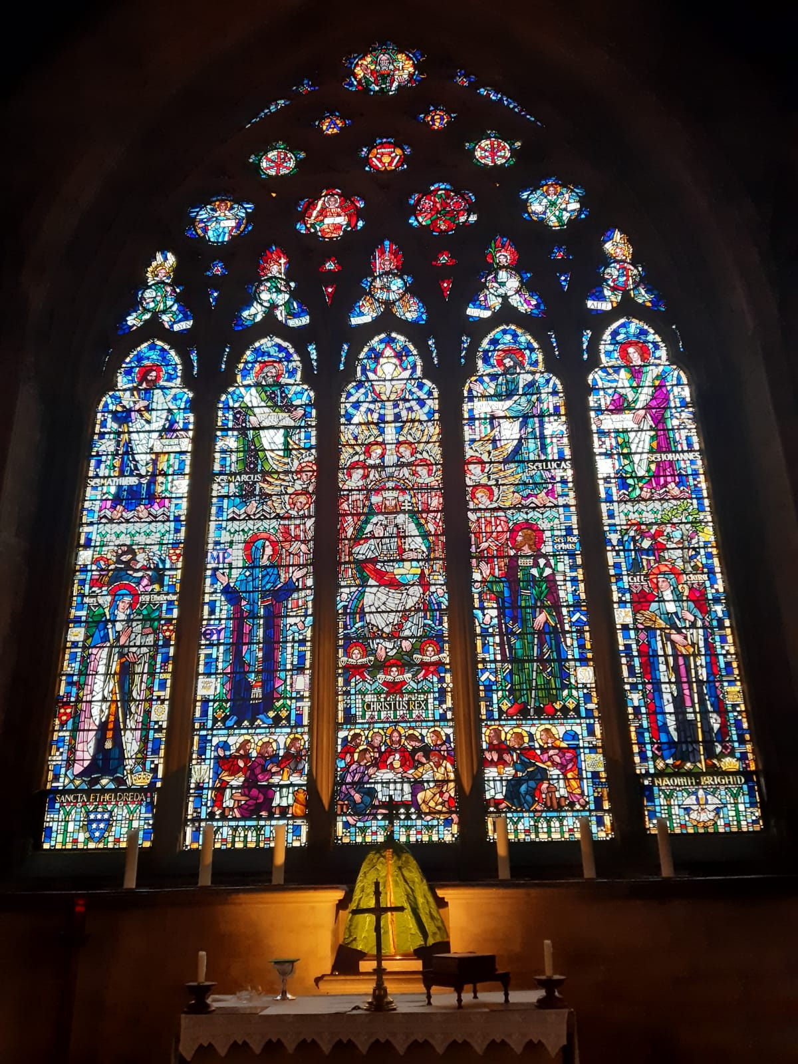
Thanks!
Enjoy the christian life!
Witness the Gospel!

